Slide 1
Is Netflix’s catalog becoming more adult-oriented?
Jingquan Yang
Over the last decade, Netflix’s catalog has quietly shifted toward mature content — let’s see how

Slide 2
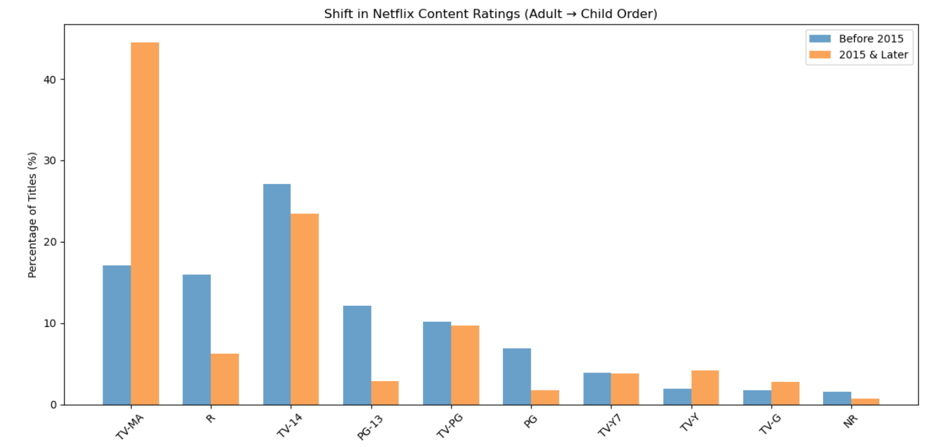
Neflix content bar chart review

Slide 3
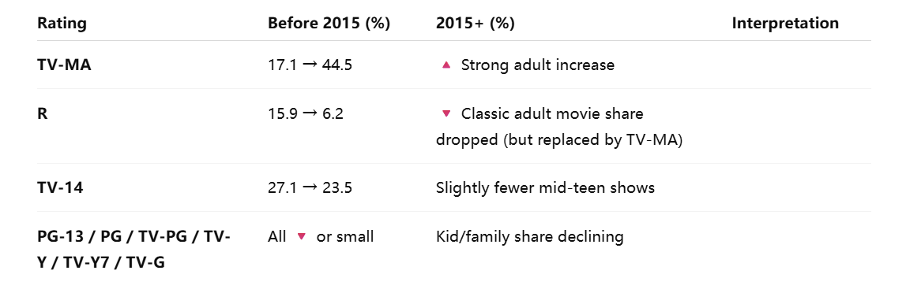
Over the past decade, Netflix has shifted heavily toward adult-oriented content — especially TV series rated TV-MA, replacing the older dominance of R or PG-13 films.

Slide 4
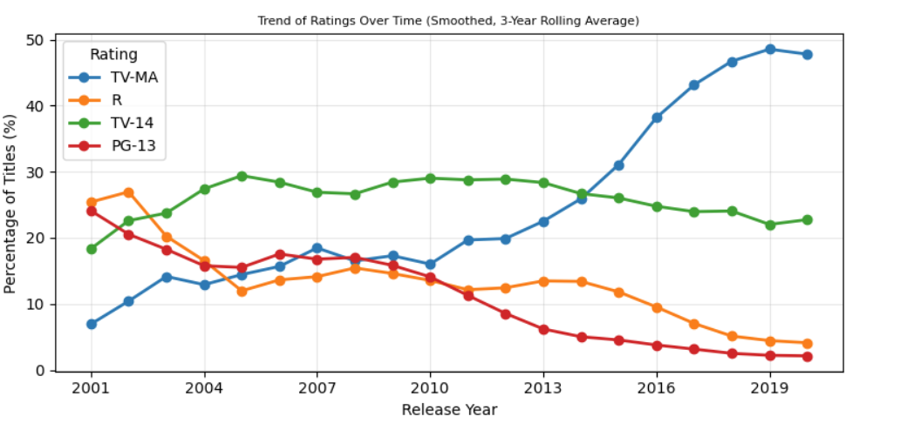
1. TV-MA keep rising from 2001 2. R has a big drop since 2002 and slight rise from 2005 but after 2014 it keep droping 3. TV-14 is relatively stable and slight increase compare 2001 4. PG-13 is gradually decline since 2001

Slide 5
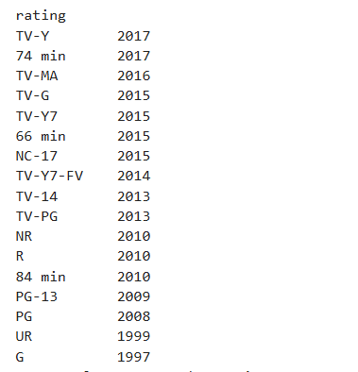
It seems like when the time pass, more sepfic rating has created for both adult and young audience.
Movie/tv length also has more category: 84, 66, 74 mins

Slide 6
Summary:
Over the past decade, Netflix’s catalog has steadily shifted toward mature-rated programming.
Around 2016—the period when Netflix began producing its own global Originals—the share of adult-rated titles accelerated sharply.
This reflects a deliberate strategy to attract adult viewers and compete with premium cable networks like HBO.

Slide 7
Bullets (presentation-ready):
🔺 Adult-rated titles grew from ~20% in 2010 to nearly 50% in 2023, with a sharp rise after 2016’s Original content boom.
📺 TV shows are more adult-oriented than movies — over half of series carry a TV-MA rating, compared with one-third of films.
🌍 International productions drive adult content growth, especially from Korea, Spain, and India, where over 60% of titles are mature-rated.

